Slide 1
Efficient in-memory integration testing
How to fully test a process involving a queue, a DB, a webservice, and a mail server, in less than 8s…

Slide 2

Vincent Fuchs
Technical head for structured finance IT in Bangalore
Associated with Societe Generale since 2006 :
As a java developer, support analyst, trainer, tech lead, offshore coordinator, dev team manager, and technical coach..
From Paris, to NYC, back to Paris, and in Bangalore since August 2014
Test infected for past 5 years
@big_Vinz
https://www.linkedin.com/in/vincentfuchs

Slide 3


Our use case : upgrading our clients based on their history
How many commands in Alice’s history ?
Incoming upgrade requests
Our application,ie our system under test
DB
queue
Save in our repository
Alice
alice@gmail.com
Send confirmation / error emails

Slide 4
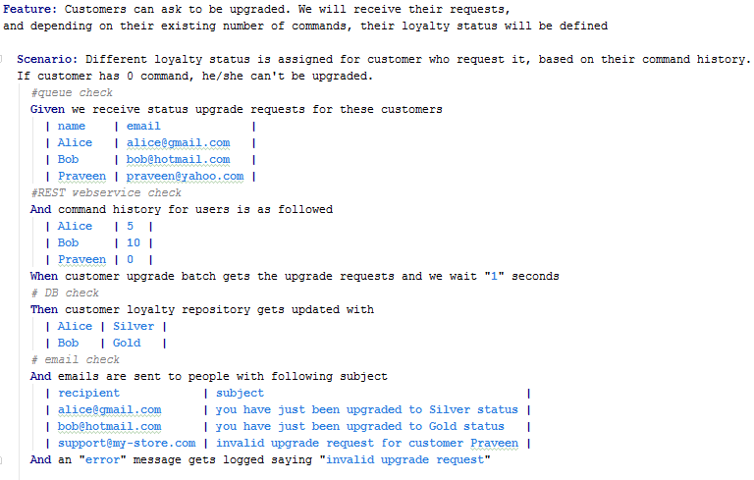
Testing using a BDD scenario

Slide 5

If you don’t have any tests…

Slide 6
We need feedback !

Slide 7
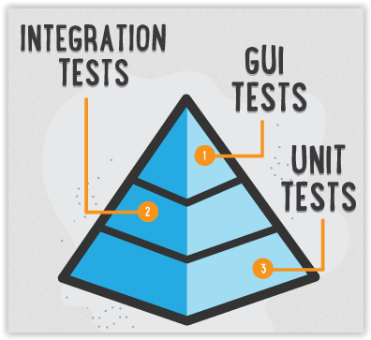
But what is integration testing ?
With frameworks like Spring, a lot of components come out of the box.
The difficult part is to configure and
arrange them correctly together.
It’s OK to have more test code than production code :
- 70 lines of Java production code
- 100 lines of XML
But 350 lines of Java test code

Slide 8
Typical challenges
when performing integration testing

Slide 9
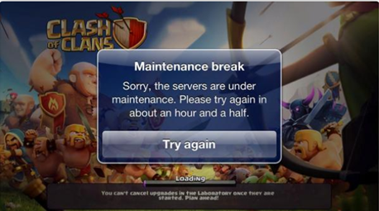

No control on the other systems on which we depend
Ready to test ?

Slide 10

Unreliable tests results

Slide 11

Shared environment(s) for our application

Slide 12
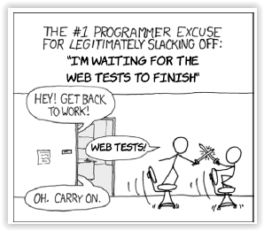
Slow to run…

Slide 13
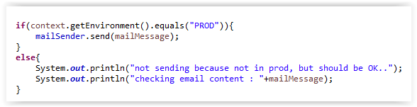
Not full coverage, because of the tradeoffs we need to make

Slide 14

Now what if… all the dependencies were running on my machine

Slide 15


What it looks like…
How many commands in Alice’s history ?
Spring Boot copy of real one
Apache ActiveMQ
Incoming upgrade requests
H2 DB
Save in our repository
Our application,ie our system under test
DB
queue
Alice
alice@gmail.com
Log4J / LogBack inMemory appender
Send confirmation / error emails
GreenMail

Slide 16
Demo

Slide 17

Awesome, I can directly to production then !

Slide 18
Caveats
Still need to test on real environments, and not only on your machine
Just to make sure that the library really follow the same standard as the real stuff
If you have stored procedures, well…
Unit tests are still faster to execute : in 8 seconds,you can run thousands of them, so test your code at the right level

Slide 19
Few things to keep in mind - conclusion
Just like for regular unit testing, invest in meaningful assertions
You have everything you need to test negative scenarios : use it ! What is supposed to happen if :
Email server is down ?
Web service is down ?
Some more libraries for other use cases :
FTP : http://mockftpserver.sourceforge.net/
SFTP : http://mina.apache.org/sshd-project/ - http://mvnrepository.com/artifact/org.apache.sshd/sshd-sftp
Custom protocol : Mountebank (http://www.mbtest.org/)

Slide 20
Thanks!
Any questions?
Example is available here :
https://github.com/vincent-fuchs/in-memory-testing
Presentation template available from http://www.slidescarnival.com/

